Slide 1


DEPARTMENT OF COMPUTER SCIENCE AND ENGINEERING
CSC1366 - HEALTHCARE DATA ANALYTICS (PRBL)
Smart Ambulance & Hospital Alert System
STUDENT NAME & REG NO: 927623BCS048 & Kishore S, 927623BCS040 & JEEVA S,927623BCS035 & HARSHAN R
DATE:

Slide 2
OBJECTIVE
The Smart Ambulance & Hospital Alert System is designed to improve emergency response and patient care by integrating technology into ambulance and hospital coordination. It provides real-time alerts to nearby hospitals whenever an ambulance is dispatched, ensuring immediate preparedness. The system also performs a hospital availability check, identifying facilities with vacant beds, doctors, and emergency services to avoid delays. Through optimized routing, ambulances are guided via the fastest path using GPS navigation, reducing travel time Additionally, it enables patient data sharing, allowing hospitals to access vital information before the patient arrives, ensuring quick treatment readiness.

Slide 3
ABSTRACT
The Smart Ambulance & Hospital Alert System is an innovative solution aimed at enhancing emergency medical response and patient care. The system ensures real-time communication between ambulances and hospitals by automatically sending alerts when an ambulance is dispatched. It identifies the nearest hospitals with available beds, doctors, and emergency facilities, while also providing optimized GPS-based routing to reduce travel time. Furthermore, it enables the sharing of critical patient information with the hospital prior to arrival, allowing medical staff to prepare in advance. By minimizing delays and improving coordination, this system significantly reduces response time, enhances treatment efficiency, and ultimately increases patient survival rates during emergencies.

Slide 4
INTRODUCTION
Smart Ambulance & Hospital Alert System project is registered under the healthcare and emergency response domain with the objective of building a smart solution that connects ambulances and hospitals for faster emergency care. It focuses on reducing response time by sending real-time alerts to hospitals, checking bed and resource availability, sharing patient details in advance, and providing optimized GPS routes for ambulances. By improving coordination and minimizing delays, the system ensures efficient medical support and increases patient survival chances during emergencies. It also strengthens the healthcare infrastructure by integrating technology into critical services. Furthermore, the system can be extended to support disaster management and large-scale emergency situations.

Slide 5
EXISTING WORK
GPS-Based Ambulance Tracking: Tracks ambulance location but lacks hospital integration.
Hospital Information Systems (HIS): Stores hospital data but not linked with ambulances.
Emergency Alert Application: Send alerts but don’t ensure hospital readiness.
Basic Communication Channels: Depend on phone calls, causing delays.
AI-Based Prediction Models:Predict hospital load but still limited in use.
Government Emergency Response Systems: Central numbers exist but lack advanced hospital coordination.

Slide 6
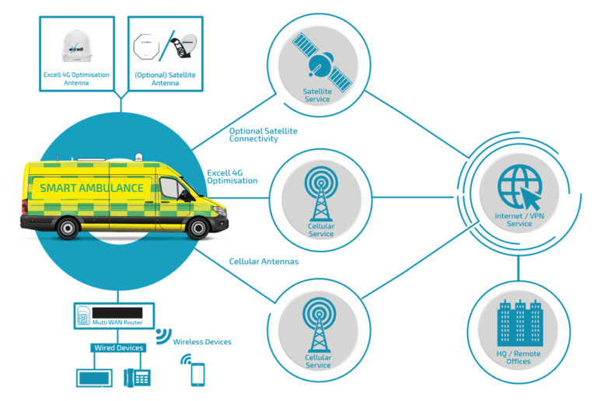
PROPOSED SYSTEM ARCHITECTURE

Slide 7
LITERATURE SURVEY
Healthcare Big Data Analytics – Enhanced patient care and resource use.
Smart Ambulance using IoT (IEEE 2021) – Lacks hospital integration.
Emergency Response with Real-Time Tracking (IJCA) – No analytics or hospital prep.
Ambulance Allocation using GIS (Elsevier) – No hospital communication.
Integrated Healthcare System (Springer 2022) – High infrastructure cost.

Slide 8
LIST OF MODULES
User/Patient Module.
Ambulance Module.
Hospital Module.
Alert & Notification Module.
Navigation & Routing Module.
Admin Module.

Slide 9
MODULE’S DESCRIPTION
User/Patient Module – Allows users or patients to register emergency requests and share basic details. It ensures that the emergency is logged and directed to the nearest ambulance service.
Ambulance Module: Manages ambulance dispatch, tracks location, and monitors status in real-time. It helps drivers receive instructions and stay connected with hospitals.
Hospital Module: Provides hospital resource details like bed availability, doctors, and facilities. It helps hospitals prepare for incoming patients before arrival.
Alert & Notification Module – Sends instant alerts to hospitals and responders during emergencies. It ensures timely communication to avoid delays in treatment.

Slide 10
MODULE’S DESCRIPTION(CONT...)
4. Alert & Notification Module – Sends instant alerts to hospitals and responders during emergencies. It ensures timely communication to avoid delays in treatment.
5. Navigation & Routing Module – Guides ambulances through the fastest GPS-based route to hospitals. It reduces travel time by avoiding traffic and roadblocks.
6. Admin Module – Oversees hospitals, ambulances, users, and ensures smooth system operation. It also manages overall security and system updates.
7. Patient Data Management Module – Shares patient health information with hospitals before arrival for timely treatment. It allows doctors to prepare equipment and staff in advance.

Slide 11
HARDWARE & SOFTWARE REQUIREMENTS

Slide 12
SCREENSHOTS

Slide 13
RESULT & DISCUSSION
The implementation of the Smart Ambulance & Hospital Alert System demonstrated effective results in reducing emergency response time and improving coordination between ambulances and hospitals. The system successfully provided real-time alerts, ensured accurate hospital availability updates, and delivered optimized routing for ambulances, leading to faster patient transfers. Patient data sharing before arrival enabled hospitals to prepare in advance, reducing treatment delays. The discussion highlights that such integration of technology enhances healthcare efficiency, minimizes manual communication errors, and increases patient survival chances during emergencies. However, it also emphasizes the need for wider adoption, regular updates, and proper training for users to achieve maximum impact.

Slide 14
CONCLUSION
In conclusion, the Smart Ambulance & Hospital Alert System proves to be an effective solution for bridging the gap between emergency services and hospitals by ensuring faster response, better coordination, and timely patient care. With real-time alerts, hospital availability checks, optimized routing, and patient data sharing, the system significantly reduces delays in treatment and enhances survival rates. By integrating technology into emergency management, it strengthens healthcare infrastructure and demonstrates the potential to save lives during critical situations.

Slide 15
Thank You
Any queries???

